Slide 1
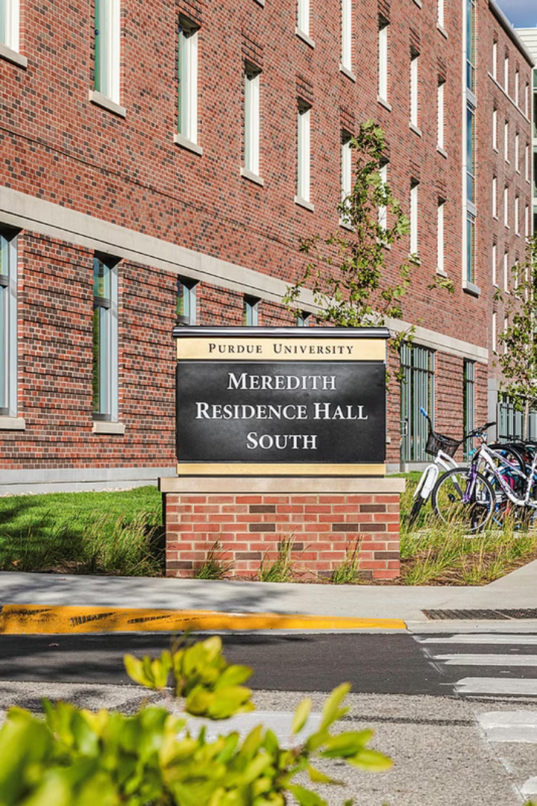

DIGITAL CAMPAIGN
@Meredith South Residence Hall
Notes:
Our campaign aimed to do more than just promote a new menu—it was an opportunity to explore what truly engages students when it comes to food marketing.

Slide 2


AGENDA
Introduction to Panera
Campaign Goal
Ad variants & Experiment
Results
Theories Applied
Analysis
Recommendations

Slide 3
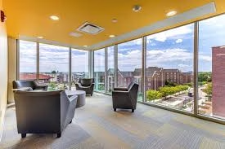

Why Panera Bread?
Strong Campus Presence
Brand Alignment with Student Values
New Menu Launch at Meredith South Hall
Recognizable Brand
Room for Creative Testing
Notes:
“We chose Panera Bread because it already has a strong presence on campus and aligns well with student values—offering fresh, convenient, and health-conscious options. With a new menu launching at the Meredith Hall location, we saw this as an ideal opportunity to test creative approaches and amplify student interest through digital ads.”

Slide 4
Campaign Goal
Objective
Location Focus
Drive awareness and interest in Panera's new menu at Meredith South Residence Hall among Purdue students.
Accessible location near Co-Rec
Engagement Strategy
Desired Outcome
Run display ad campaign using Google Ads with visual and brand variations to study what resonates most with students.
Understand which creative elements (color, ) drive more attention and engagement to inform future promotions.
Notes:
Our main objective was to raise awareness and spark interest in the new Panera menu at Meredith Hall. We focused on students and faculty, given the location’s proximity to the Co-Rec. The campaign was executed through G Ads, using different visual and brand elements to see which combo would drive the most attention and engagement. Ultimately, our goal was to understand what creative elements like background color or imagery—most effectively capture our audience’s interest.”

Slide 5
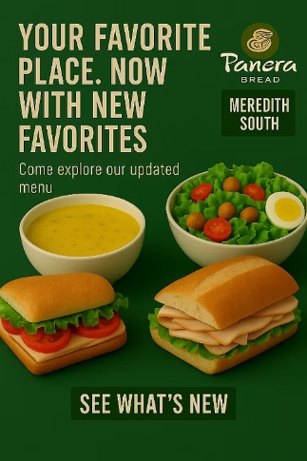
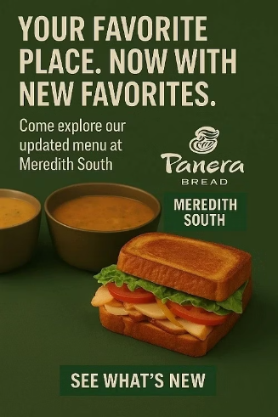
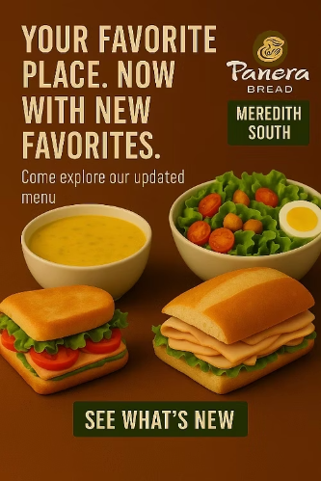
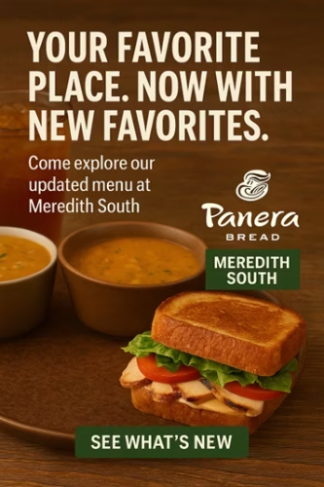
Ad Variants
Notes:
We thought it would be interesting to test what kind of visual design drives the most engagement, we set up a simple but structured experiment using a 2x2 A/B testing framework We created four ad variants by combining two background colors — Panera’s signature green and a neutral brown — with two food imagery styles: fresh vegetables versus comfort food." "This gave us Ad 1 through Ad 4, each testing a unique visual combination."

Slide 6
Hypothesis
Ads with Panera’s green background + fresh vegetables (Ad A) will perform best
Reasoning:
Green evokes freshness and health
Veggies boost visual nutrition appeal
Together = higher engagement from health-conscious students

Slide 7
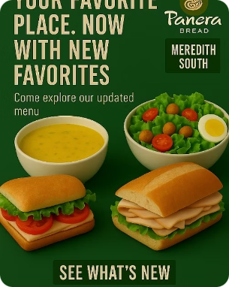
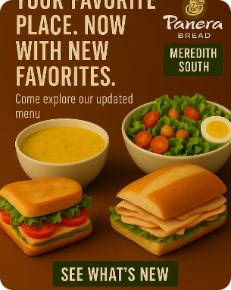
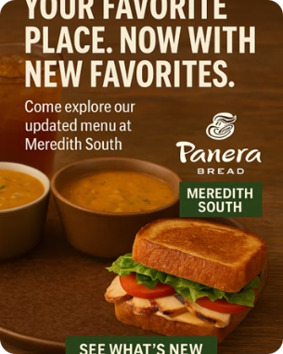
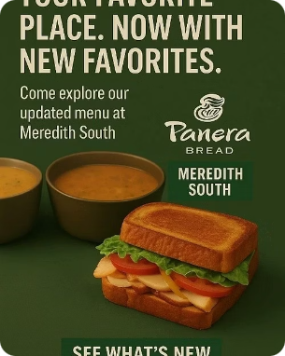
Experiment
Objective: Isolate the impact of two visual variables on ad engagement:
Metric Focus:
Background Colors – Green vs Brown
CTR
Food Imagery – Veggies vs Comfort Food
CPC
Controlled Factors:
Engagement
Impressions
Same copy, layout, target, budget, and platform
Clicks
With Veggies
Without Veggies

Slide 8

RESULTS

Slide 9
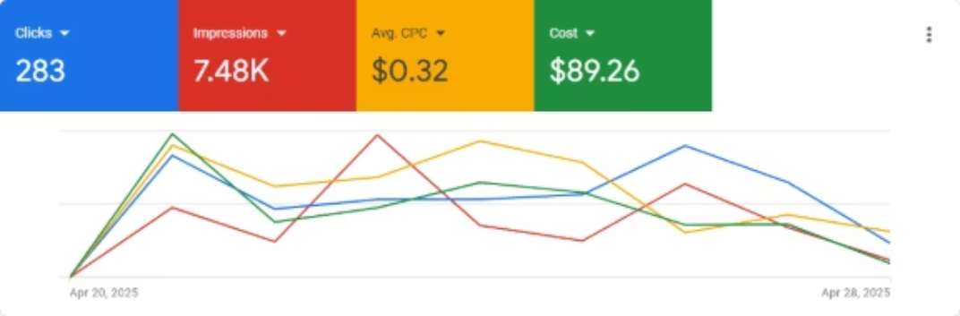
Campaign Performance Over Time
📈 Total Clicks: 283 | 📢 Impressions: 7,480
💰 Avg. CPC: $0.32 | 🟢 Total Spend: $89.26
🧠 Insight: Peak engagement occurred between April 21–24. Ad activity declined near campaign end.

Slide 10
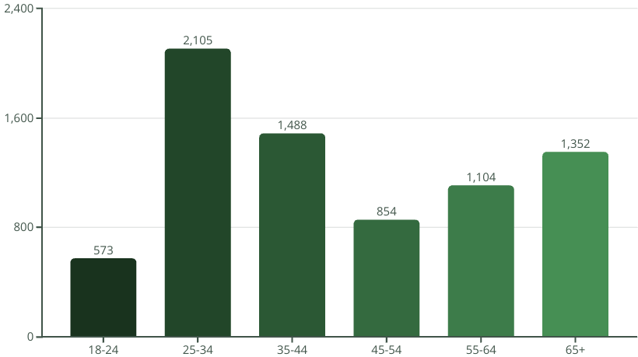
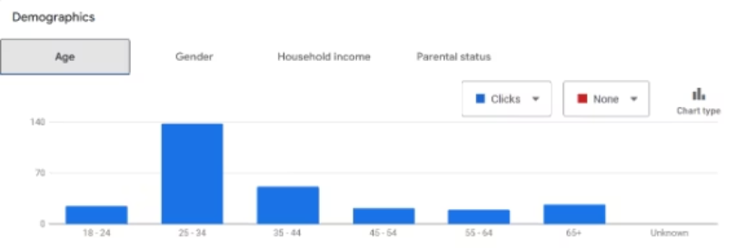
Impressions by Age Range

Slide 11
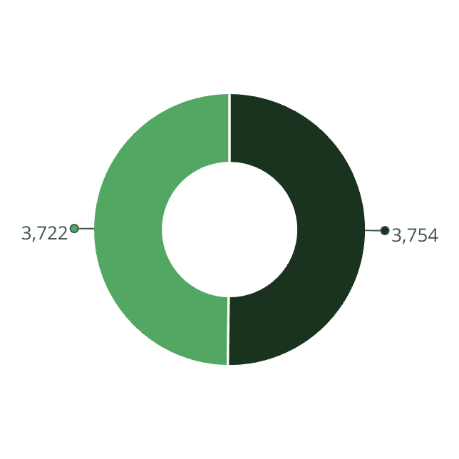
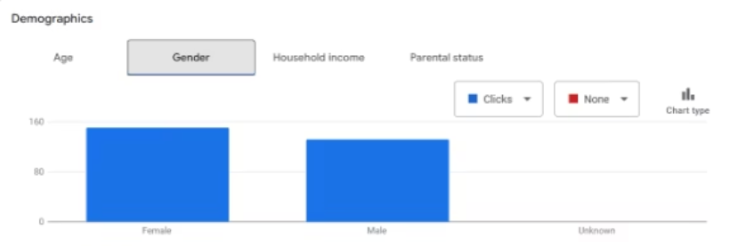
Impressions by Gender
Male
Female

Slide 12
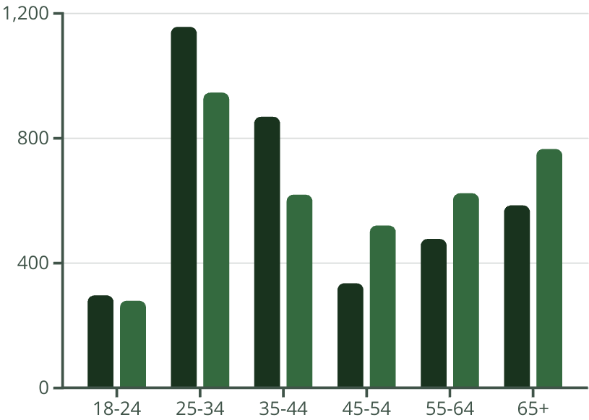
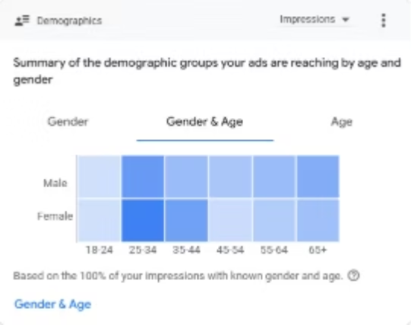
Impressions by Age and Gender
Female
Male

Slide 13
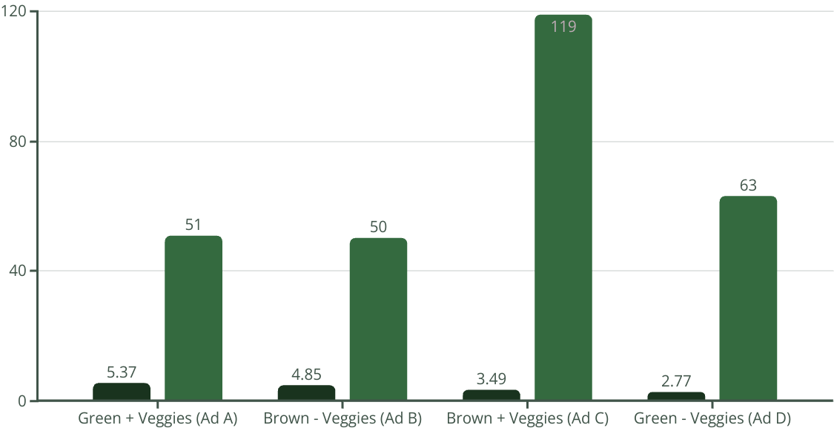
Results by Campaign
Let's examine the key metrics from our Panera Bread campaign to understand what drove success across different ad variants.
CTR (%)
clicks
The data reveals that brand color (green) combined with health-oriented imagery (vegetables) delivered the highest engagement. This supports our behavioral theories about visual perception and familiarity effects.
Color psychology and visual content clearly impacted user behavior more than expected, with the right combination increasing CTR by nearly 2x compared to less effective variants.

Slide 14
Behavioral Theories Applied
1. Sensory Marketing
"We engage the senses to shape behavior."
Theory: Visual elements (color, imagery) influence perception and emotion
Application:
Green background evoked freshness, health, and brand identity
Ads with vegetables enhanced visual appeal to health-conscious consumers
Outcome:
Ad A (Green + Veggies) had highest CTR: 5.37%

Slide 15
Behavioral Theories Applied
2. Mere Exposure Effect
"Familiarity breeds preference."
Theory:
Repeated or brand-consistent visuals boost trust and click behavior
Application:
Panera's signature green & known products = higher comfort & engagement
Outcome:
Despite fewer impressions, Ad A outperformed Ad C in CTR
Shows that recognizability > reach

Slide 16
Analysis
Key Insights
Consumer Behavior Theory
Brown + Comfort Food = Emotional Appeal​
Maslow’s Hierarchy of Needs​
Lower CTR but high click volume
Triggered psychological needs like comfort & warmth — especially under academic stress (finals week).
Evening & Thursday = Peak Engagement
Temporal Cues & Behavioral Patterns​
Taps into habitual consumption behavior and temporal segmentation. Suggests timing strategies should align with natural rhythms of student decision-making and availability.​
Age 25–34 = Most Responsive Segment
Psychographic Segmentation​
Likely more health-conscious, brand-aware, and autonomous in food choices. Strategy: targeting consumers based on values, lifestyle, and self-image.

Slide 17
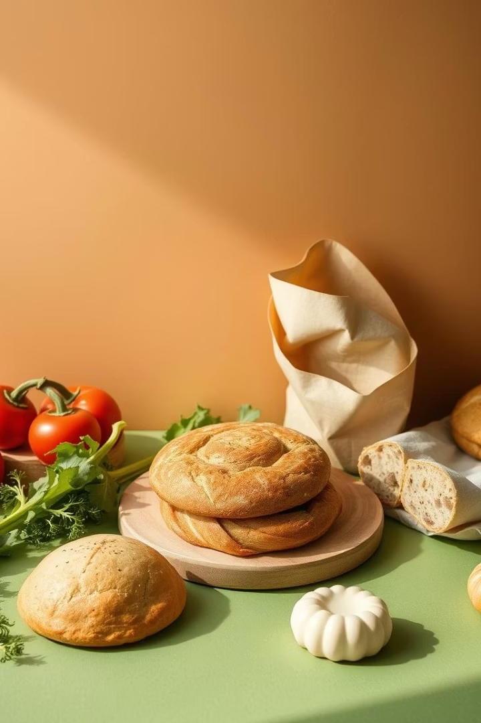
Recommendations for Future Panera Campaigns
Use Panera's brand colors: rich green and warm brown for visuals.
Leverage High-Performing Visuals
Continue using green background + fresh veggies for high engagement (5.37% CTR).
Emphasize freshness and health in future messaging for health-conscious students.
Incorporate Comfort Appeal
Use brown background + comfort food in colder seasons or finals week for emotional connection.
These ads had strong performance (4.79% CTR), especially with grilled cheese and soup visuals.

Slide 18

Optimizing Timing and Comfort Appeal
Optimize Timing
Improve Experience Consistency
Extend campaign timeline to benefit from the mere exposure effect.
Align visual promises (fresh, vibrant food) with real in-store experience to avoid negative disconfirmation.
Focus on evenings on weekdays, especially Thursdays, based on peak impressions.
Audit actual food presentation, portion sizes, and freshness regularly.
Increase ad visibility at peak lunch times (11 AM - 1 PM).
Refine Demographic Targeting
Double down on ages 25–34, the most engaged group.
Explore creative formats/platforms (e.g., Instagram or YouTube) to reach younger or new segments.

